Slide 1
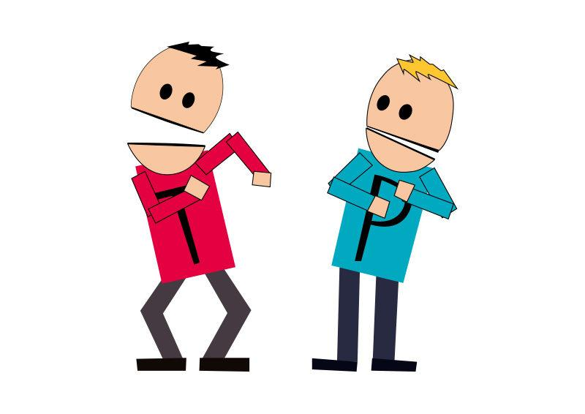
HI BUDDY
The App that helps track your high

Slide 2


Is your activity feeling routine?
Boring
Habit
Gone too soon
Just down right not enjoyable

Slide 3

THERE’S AN APP FOR THAT……
…….Eventually

Slide 4


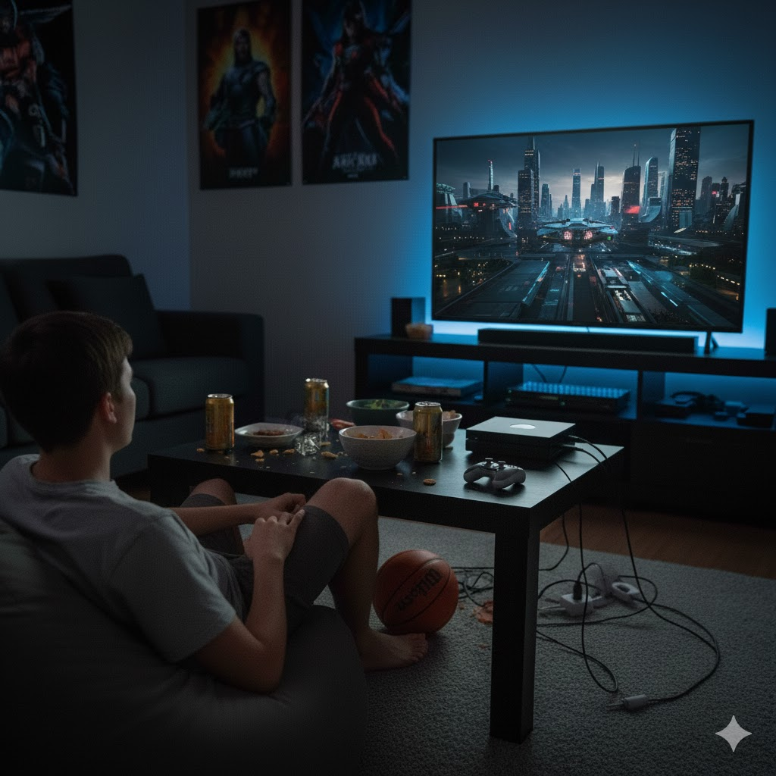
HI-BUDDY
The App helps track and optimise your high.
Matches your sparking activity with another activity.
Based off strain, history and mood
Gives A list of recommendations.

Slide 5

Who it affects and what does it need?
-The Hi-Buddy app is intended to help stoners, lazy and bored people, and party poopers.
-To properly run it needs user interaction and a base level of interaction from the patient. After all they are your buddy,guy.
- Needs to be able to pull from a multiple number of databases such as Video games, music and movies ( I don’t mean information but example: Netflix’s funny movie compared to Disney’s funny movie selection).

Slide 6
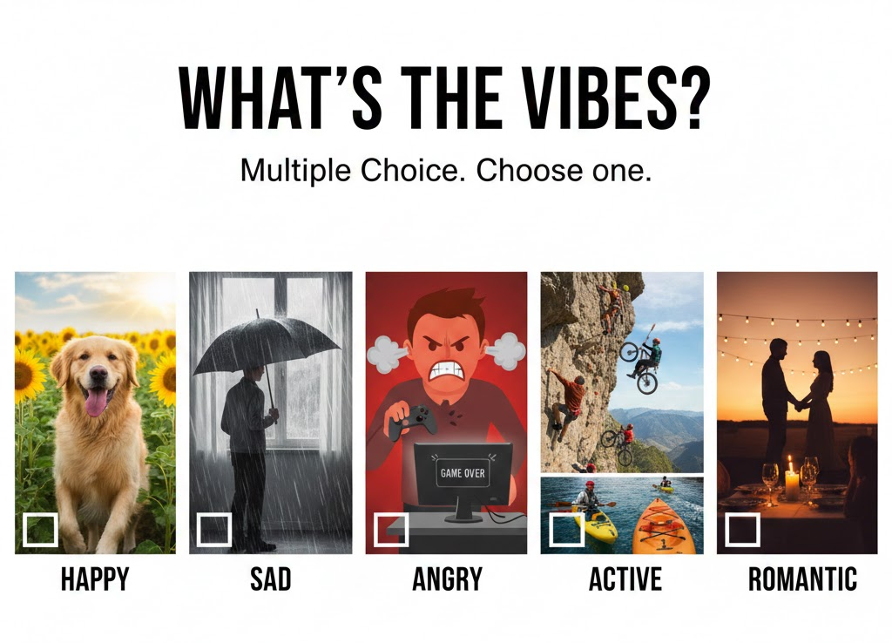
How it works?
You are presented with a box to choose your emotion or whatever is close to your emotion you are feeling.
#include <iostream>
#include <string>
using namespace std;
int main() {
string answer;
cout << "(1) Happy”\n;
cout << "(2) Sad”\n;
cout << "(3) Hyper”\n;
cout << "(4) Romantical”\n;
cout << "(5) Angry”\n;
cout << "Choose a mood: ";
cin >> answer;
cout << "You selected option: " << answer << "\n";
return 0;
}

Slide 7

Then you are presented with Display a box of activities that matches with your mood, first to raise your hope meter is the one. (Swipe Left for no, Swipe Right for winner)
The Box has a main and under it are suggestions to try, based off previous user entries.

Slide 8
LE CODE
#include <iostream>
#include <string>
using namespace std;
// Function to display the activities based on the user's mood choice
void ShowActivityBox(const string& mood) {
cout << "\n----------------------------------\n";
cout << " YOUR ACTIVITY BOX \n";
cout << "----------------------------------\n";
if (mood == "1") {
cout << "HI-BUDDY: FUNNY MOVIES\n";
cout << "- Ted (Peacock)\n";
cout << "- Bridesmaids (Netflix)\n";
cout << "- The Hangover (Hulu)\n";
cout << "- Anchorman (Paramount+)\n";
cout << "- Superbad (Prime Video)\n";
}
else if (mood == "2") {
cout << "SAD MODE: COMFORT ACTIVITIES\n";
cout << "- Warm tea + blanket\n";
cout << "- Soft music playlist\n";
cout << "- Light walk outside\n";
cout << "- Write how you feel\n";
cout << "- Watch a calming show\n";
}
else if (mood == "3") {
cout << "HYPER MODE: ENERGY BOOSTERS\n";
cout << "- Fun challenges\n";
cout << "- Quick dance session\n";
cout << "- Competitive mini-games\n";
cout << "- Try a new hobby\n";
}
else if (mood == "4") {
cout << "ROMANTIC VIBES: LOVE MOMENTS\n";
cout << "- Romantic movie\n";
cout << "- Candle-lit vibe\n";
cout << "- Write a love letter\n";
cout << "- Slow playlist time\n";
}
else if (mood == "5") {
cout << "ANGRY MODE: RELEASE ACTIVITIES\n";
cout << "- Deep breathing\n";
cout << "- Punch pillow (safe)\n";
cout << "- Fast walk\n";
cout << "- Journal anger\n";
cout << "- Calming games\n";
}
else {
cout << "Invalid mood option.\n";
}
cout << "----------------------------------\n\n";
}
int main() {
string answer;
cout << "Select your mood:\n";
cout << "(1) Happy\n";
cout << "(2) Sad\n";
cout << "(3) Hyper\n";
cout << "(4) Romantic\n";
cout << "(5) Angry\n";
cout << "Choose mood number: ";
cin >> answer;
ShowActivityBox(answer);
return 0;
}

